Slide 1
The Heavenly Realms
Lecture 2 of the Spiritual Warfare Seminar
By John Edmiston B.Sc. B.D.

Slide 2
Limited Knowledge…
Our knowledge of the heavenly realms is fairly limited, we do not have exact knowledge of angelic or demonic hierarchies etc. The “hidden things belong to God” (Deut 29:29)
We “know in part and we prophesy in part (1 Cor 13:9) but we can be perfected in love (Matt 5:44-48). The goal of Christian instruction is not perfect knowledge which we can NEVER attain in the flesh but perfect love (1 Cor 8:1, 1 Jn 3:1-4)
In this lecture we will stick with what the Bible says and not add anything from extra-biblical sources e.g. Jewish claims about seven heavens- 1 Tim 1:4-7, 2 Tim 4:4, Titus 1:14

Slide 3
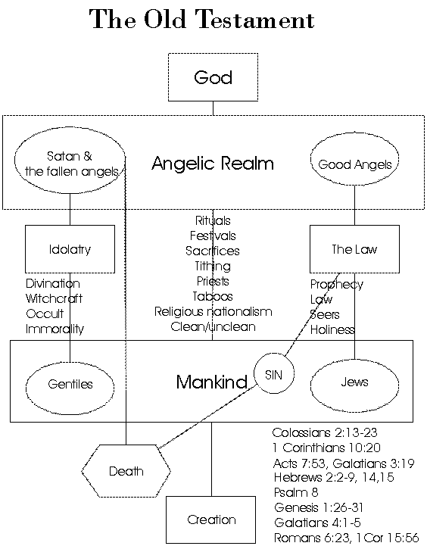

Slide 4
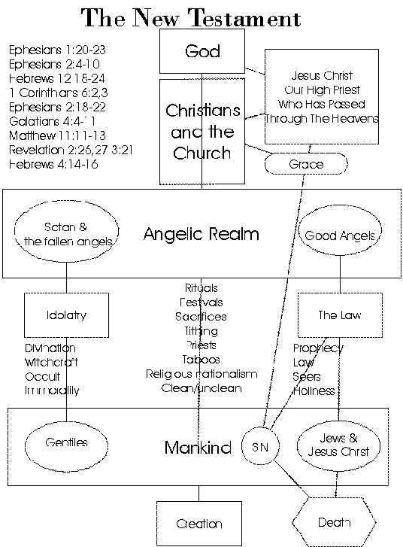

Slide 5
The Heavenly Realms
Above the Heavens - God – A Place of Great Glory
3rd Heaven – The Throne of God
Satan was cast out of the Third Heaven, was in the 2nd Heaven before the cross. After being defeated by Christ he is now ‘prince of the power of the air (1st heaven)
2nd Heaven – Angels / Spiritual Warfare
1st heaven - Air
Satan will be cast to the Earth and this will bring about the Tribulation, he will then end up in the Pit and later in the Lake of Fire
Earth
Abraham’s Bosom (Good)
Sheol
Hades – Bad ?Torment
At the cross Sheol was emptied of the good . And the bad area Hades became Hell
Hades /Hell
The Pit
The Lake Of Fire

Slide 6
The Three Heavens
The word Heaven is plural “shamayim” or “ouranoi” (Gk). There are three heavens or “shamayim” mentioned in Scripture.
Above the Heavens – where God’s glory dwells and where Satan once aimed to be. (Psalm 8:1, 108:4,5, Ephesians 1:20, 4:10, Isaiah 14:12-14)
Third Heaven (2 Corinthians 12:2) – the Throne, where Paul went and heard holy things.
Second Heaven (Revelation 12:4-12, 14:6,7) –Where Satan and fallen angels first fell to and demons are fighting for now. First Heaven (Genesis 1:20, Psalm 104:12, Daniel 2:38) – birds dwell, Satan dwells as prince of the power of the air since the cross.

Slide 7
The Lower Realms
Earth esp. “The Face Of The Earth” (Genesis 6:1, Acts 17:26Job 1:7,2:2, 1 Peter 5:8) – the place of human habitation, also where Satan prowls, and will be cast down to in the end times. Hades/ The Grave/Under The Earth /In The Sea/The Deep (Genesis 1:2, Exodus 20:4, Deuteronomy 5:8, Job 28:14, Philippians 2:10, Revelation 5:3) – the place human bodies, human souls before the cross, and the strange creatures of the deep dwell. In 1 Samuel 28:15 the prophet is “brought up” by the witch of Endor. Presently where the souls of the disgraced dead dwell. n Matthew 27:52,53 there is a partial resurrection of the righteous OT saints “from the graves”. Abyss/the Bottomless Pit/(Isaiah 14:11-15; Numbers 16:33, Ezekiel 32:15-18 Luke 8:31, 10:7, Revelation 9:1,2; 20:1-3) – where confined demons dwell The Lake of Fire (Revelation 19;20, 20:10-15) – a future place of eternal punishment prepared for the Devil and his angels and those who accept the mark of the Beast.

Slide 8
Lower Realms - 2
“Sheol” is a general Hebrew term covering the entire world of the dead. Luke 16 indicates that Abraham’s bosom is a place of comfort in the OT world of the dead. Job indicates that some of the dead experienced rest and reunion with relatives hence the term ‘gathered to one’s people”. (Job 3:17-22, Genesis 15:15, 25:8,17; Deut 32:50). Abraham’s Bosom was emptied at the croso.
Abbadon or Destruction (Gk Apollyon) is the name of the angel that guards the Pit (Revelation 9:11) and thus Hell is given the name Abaddon in Job 26:6, 28:22, Proverbs 15;11. It is seen as a place of silence, loss of identity and oblivion as well as of torment. There is no knowledge of God just active torment and judgment. (Pslam 6:5, 88:12, Deut 32:22) God’s Presence is till there – as wrath. (Psalm 139;8)
Tartarus was the legendary Greek place of extreme torment. 2 Peter 2:4 indicates that the rebellious demons were confined here. It seems equivalent to the Pit.

Slide 9
The Rebels Against God
The angels who sinned (2 Peter 2:4) and are now kept in chains awaiting judgment
Those who are ‘principalities and powers in the heavenly realms’ and ‘of the air’ (Ephesians 6:10, 2:1-4) and which influence mankind today (2 Thessalonians 2:7,9)
The demons and unclean spirits that dwell in human bodies and even seek water. (Matthew 8:28-34, 12:22-28, 43-45)
These beings only have the authority that we grant them through sin because they have no authority from God
They do have a certain amount of power and wicked energy

Slide 10
Who Is Satan?
The Prince of the Power of the Air (Ephesians 2:1-4)
Ruler of This World (Jn 12:32, 1 Jn 5:18,19, Lk 4:1-13)
The Accuser of the Brethren (Rev 12:10, Zech 3:1-11)
Lucifer / Light-Bearer /Venus (Isaiah 14:12-14)
The Devil /Adversary / Accuser (Matt 4:1-11, 1Pet 5:8)
Satan / Opposer / Hinderer (Mark 1:13, Job chapter 1)
Apollyon/Abbadon/Destroyer (Revelation 9:11)
Angel of Light / Star (2 Corinthians 11:14, Rev 9:1)
Anointed Covering Cherub (Ezekiel 28:14)
Beelzebub / Lord of the Flies (Matthew 12:24)
Belial (2 Corinthians 6:15)
Dragon / Leviathan / Serpent (Rev 12:9, Isa 27:1)
Enemy (Matthew 13:39)
Evil One / Wicked One (John 17:15, Ephesians 6:16))
Lawless One (2 Thessalonians 2:8-10)
Deceiver / Father of Lies (John 8:44, Rev 12:9)
Tempter (Matthew 4:3)
Murderer / Thief / Destroyer (John 8;44, John 10:10)
Prince of Tyre / Prince of World Trade (Ezekiel 28)

Slide 11
How Satan Operates
Satan operates through false religions which are in fact the worship of demons (1 Cor 10:19,20)
And through abominable objects called “idols” (Deut 7:25,26) and their rituals (1 Cor 10:20)
Through sorcery, magic and divination (Deut 18:9-14) which especially deceive the merchants and kings of the earth (Revelation 18:23)
Satan also operates through witches, wizards, shamans and false prophets such as Baalam who try to curse people (Numbers 22:11)
International trade and the merchandising of religion are the centers of his iniquity (Ezekiel 28:16-18)
Satan is violent, aims to steal kill and destroy, persecutes the righteous and has been a liar and a murderer from the beginning (Revelation 12:1-11, John10:10, John 8:44)
Satan seeks to tempt, accuse and devour immature Christians (1 Peter 5:8)

Slide 12
The Good Angels
Are ministering spirits who aid those being saved (Hebrews 1:14)
Are less in rank than Jesus Christ (Heb1:4-14)
Will be judged by believers (1 Cor 6:2,3)
Have various duties such as carrying messages (Gabriel Dan 8:16, 9:21, Lk 1;19,26)) and fighting wars (Michael – Dan 10;13,21; 12:1, Jude 1:9; Rev 12:7)
Engage the forces of darkness (Dan 10, Rev 12)
Implement God’s judgments (Rev 16)
Sometimes fight in human wars such as against the Assyrians (Isaiah 37;36)
Can inflict plagues e.g the Ten Plagues in Egypt, the Last Plagues (Rev 15:1-8) and the plague on Israel under David (1 Chr 21:11-30)
We are not to worship angels (Col 2:18, Rev 22:8,9) but to worship God alone whom the angels worship (Rev 7:11, Heb 1:6, Phil 2:11)

Slide 13
Intro: Curses and Blessings
(This will be explored in detail later in session 6)
Words of power that take effect in the spiritual realms and affect the operation of things in the natural realm, often over an extended period of time.
Blessings – Genesis 1 – be fruitful, multiply, have dominion. Exponential results, expansion, power, respect, authority.
Curses – Genesis 3 – hard work/ poor results/ lack of fruitfulness pain in multiplication, utter humiliation “eating the dirt”.
For Christians curses are broken on the Cross (Galatians 3:10-14, Col 2:13-15) and we have all blessings (Eph 1:3) including those of Abraham (Galatians 3:9, 4,29)

Slide 14
Spiritual Promises
Spiritual promises are very powerful words from God that are activated by faith and patience. (Hebrews 6:12-20)
These promises give us all that is required for life and godliness and enable us to share in the divine nature, escape our lusts and temptations, and win the battle. ( 2 Pet 1:2-4)
Promises are of FAITH not works, we do not earn them, we receive them through faith (Romans 4:13-25, Gal 3:22, Hebrews 11)
God said, it, I believe it, I receive it, let’s do it!
Blessings and curses are already activated, promises require activation through faith.
The Holy Spirit guides us in how to pray the promises (Romans 8:26)
The old Levitical priesthood administered laws and curses and blessings, but the eternal priesthood of Melchizedek is based on grace and administers promises (Heb 7:6, 28; 8:6)

