Slide 1
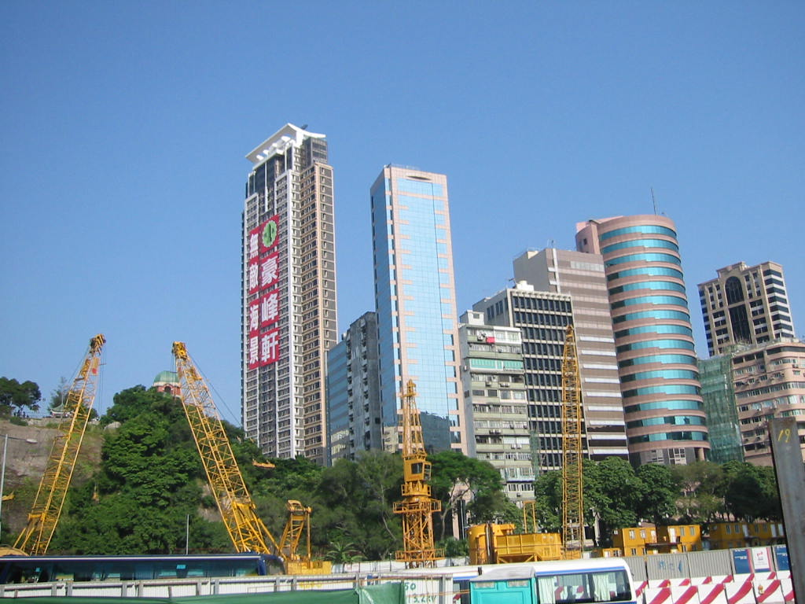
Praying for your city
So that revival comes…..

Slide 2
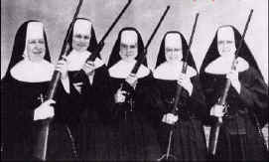
About This Lesson
Part 1 – The Spiritual Nature Of Cities
Part 2 - Praying For Your City

Slide 3
Our Prosperity Flows From Our City
Jeremiah 29:7 GW Work for the good of the city where I've taken you as captives, and pray to the LORD for that city. When it prospers, you will also prosper.
Though Babylon was not a godly city God told the Jews to seek the good of the city - and to PRAY FOR IT
As they did this, and the city prospered, they too would prosper

Slide 4
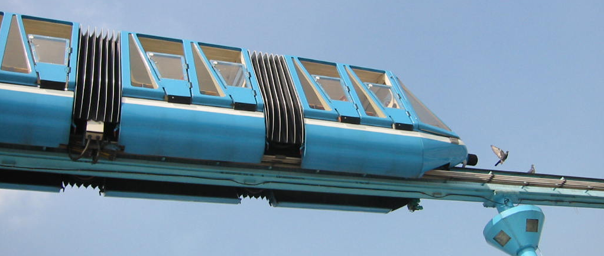
Cities Have “Spiritual Characteristics”
Zion – City of God (Psalm 48:2,8)
Pergamum – where Satan’s throne is (Revelation 2:12,13)
Tekoa – city of wisdom (2 Samuel 14:1-4, Amos 1:1)
Tyre – city of unjust trade (Psalm 45:12, Ezekiel 28, Isaiah 23)
Gaza – originally a Philistine city meaning strong or stronghold

Slide 5
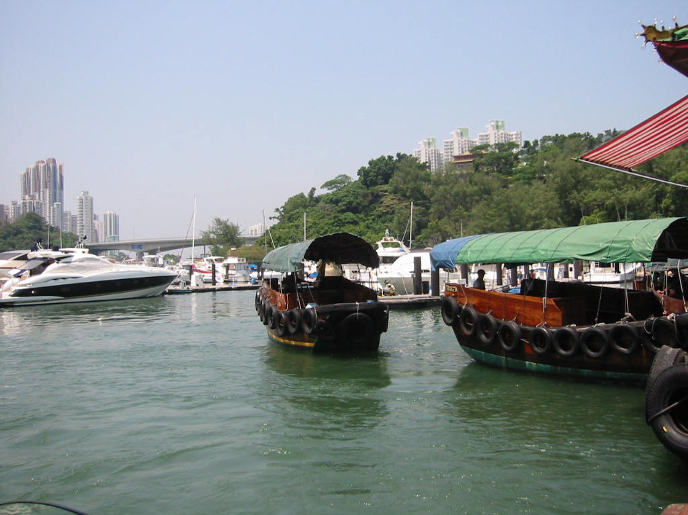
Characteristics Part 2
What are some of the spiritual characteristics of?
Las Vegas
Paris
Hong Kong
Mecca
Rome
Shanghai, China
Thimpu (the capital of Tibet)
Geneva

Slide 6
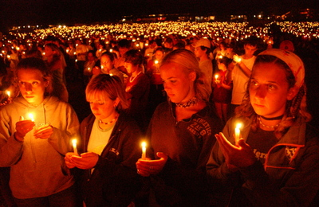
Cities Had Temples & Gods Associated With Them
Zeus – Pergamum
Dagon – Gaza
Artemis – Ephesus
Emperor worship – Rome
YHWH – Jerusalem
Allah – Mecca
There often was a formal pact between the citizens of the city and the god of the city celebrated in an annual festival or ‘carnival’.

Slide 7
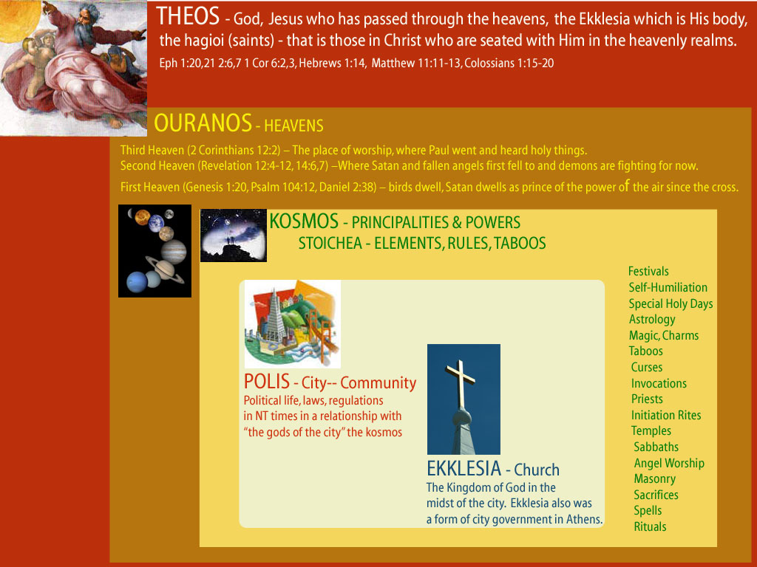

Slide 8
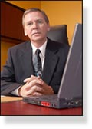
Prophets, Priests and Kings…
Every major city has its ‘prophets, priests and kings’
Kings: Mayor, police chief, politicians & community elders, rich powerful and influential people
Priests: Serve the deity of the city – God, Mammon, Luck/feng-shui, Buddha, Allah etc.
Prophets: Oracles, prophets, some artists (at a spiritual level), singers, communicators, story-tellers, movie makers

Slide 9
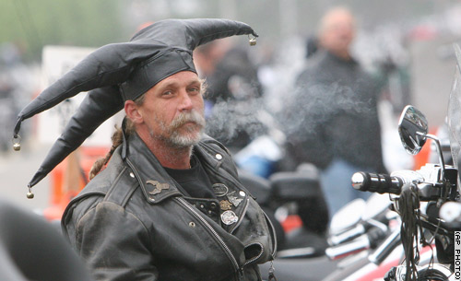
Cities Are Multi-Layered
Cities have many levels & social & economic strata
They also may have many active religions (e.g. L.A.)
Underworld communities & gangs
Refugee and migrant communities
High culture
Business, industry and trade
Women often have a completely different life (e.g. in some parts of the Arab world)

Slide 10
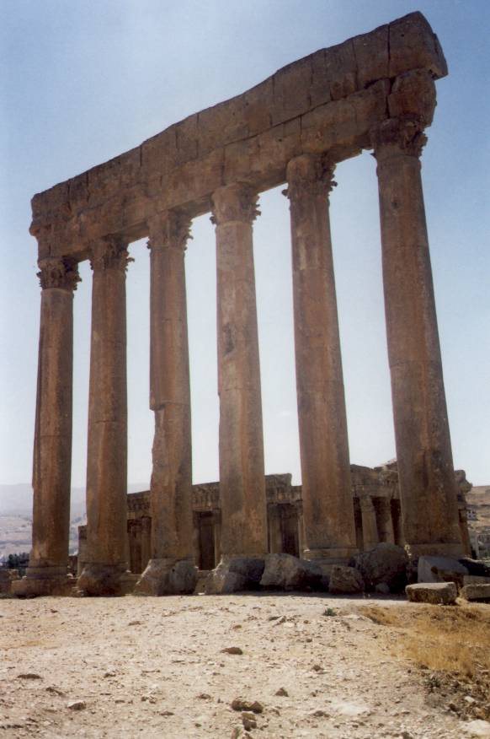
Cities Can Experience Judgment
Matthew 11:20-24 HCSB Then He proceeded to denounce the towns where most of His miracles were done, because they did not repent: (21) "Woe to you, Chorazin! Woe to you, Bethsaida! For if the miracles that were done in you had been done in Tyre and Sidon, they would have repented in sackcloth and ashes long ago! (22) But I tell you, it will be more tolerable for Tyre and Sidon on the day of judgment than for you. (23) And you, Capernaum, will you be exalted to heaven? You will go down to Hades. For if the miracles that were done in you had been done in Sodom, it would have remained until today. (24) But I tell you, it will be more tolerable for the land of Sodom on the day of judgment than for you."

Slide 11

Cities Can Experience Salvation
Isaiah 26:1 HCSB On that day this song will be sung in the land of Judah: We have a strong city. Salvation is established as walls and ramparts.
Acts 8:5-8 HCSB Philip went down to a city in Samaria and preached the Messiah to them. (6) The crowds paid attention with one mind to what Philip said, as they heard and saw the signs he was performing. (7) For unclean spirits, crying out with a loud voice, came out of many who were possessed, and many who were paralyzed and lame were healed. (8) So there was great joy in that city.

Slide 12
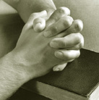
Part 2 – Praying For Cities

Slide 13
Get A Map & Read Some History
Get out a map of the city and work out ‘what happens where’ – where are the most churches, where are the gang areas, industrial areas and so on.
Read about the origins and history of the city – especially acts of great injustice, war and social trauma and devastation.
Start ‘praying over’ the map and the historical events for leadings from God. Get a sense of what God is saying about the city.

Slide 14
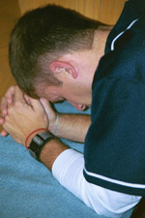
Repentance, Faith and Unity
The leaders of the churches in the city should repent of divisions, accusations, immorality and known sin.
They should come together in regular public expressions of spiritual unity (among born-again bible-believing Christians)
The individual Christians should commit to a life of repentance, faith and intercession for the city

Slide 15
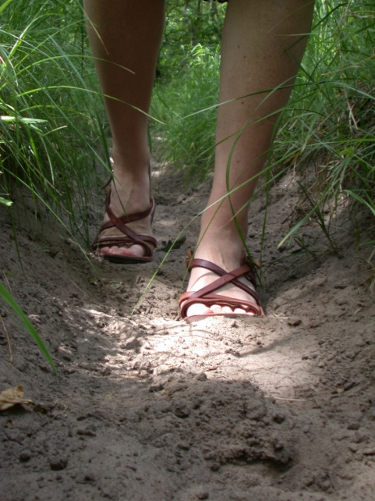
Prayer Walking
Start walking the streets of your neighborhood praying for people and houses.
If you have enough people allocate teams to cover the whole city (get your exercise and pray in a revival at the same time!)
As you get specific information about people e.g. “the McDaniels at 32 Leafy St. have just had a child” - pray for those people
Generally within three months the evangelistic harvest will greatly increase

Slide 16
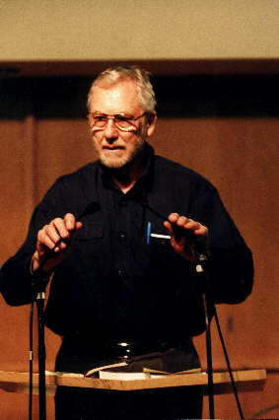
Praying For Cities - 1
Pray for the city ‘elders’ (Kings)
Pray for the artistic community (Prophets)
Pray for the spiritual leaders (Priests)
Have teams of intercessors allocated to each of these three areas
Build relationships with key people and pray personally for them

Slide 17
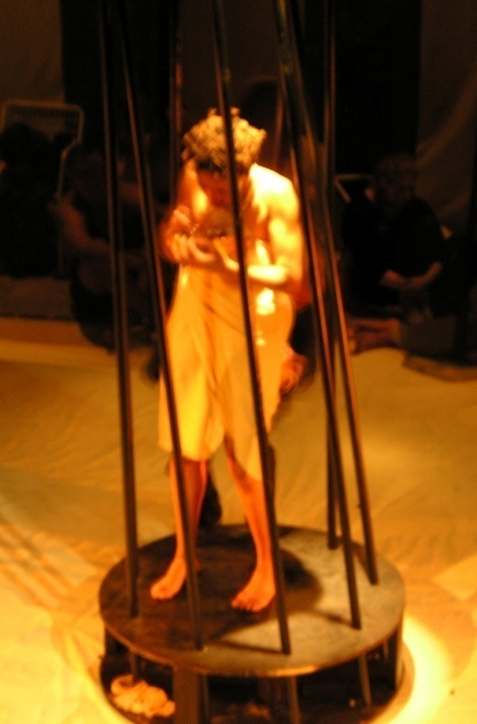
Praying For Cities -2
Pray against the grip of the ‘prevailing sins’ of the city e.g. homosexuality, drug use, sensuality etc. – name the demons and rebuke them!
Pray against the prevailing systems of ungodly worship and spiritual deception (2 Corinthians 4:4, 2 Corinthians 10:3-5)

Slide 18
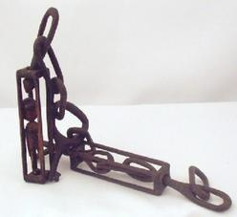
Praying For Cities - 3
Pray for the breaking of spiritual compacts with the realms of darkness e.g. in Haiti which was consecrated to the Devil by the sacrifice of a wild boar in the forest.
Pray against festivals and celebrations of the powers of darkness and against particular customs that keep people in darkness and bondage
Pray for the removal of ‘stinking thinking’ – and for the renewal of the minds of people in that city - so that they think high and noble thoughts (Isaiah 32:8, Philippians 4:8)

Slide 19
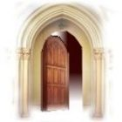
Praying For Cities - 4
Pray that a door will open for the gospel to be mightily proclaimed in that city:
(Acts 14:27, 1 Corinthians 16:9,
2 Corinthians 2:12, Colossians 4:3)
Pray that the instruments of communication – TV, radio, Internet, newspapers and so on may give space for the proclamation of the gospel
Pray that the enemies of the gospel will be refuted and silenced

Slide 20
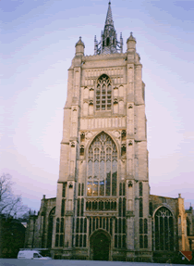
Praying For Cities - 5
Pray for economic prosperity
Pray for good education and wise leadership
Pray for sensible and righteous government
Pray that Christians may have influence
Pray that God’s will be done & His Kingdom come
Pray for “shalom’ – peace, order and good relationships, so that it will become a place of blessing

