Slide 1
Authority & Power In Prayer

Slide 2
Authority
Authority – (Gk. “exousia’)
Positional authority, command authority, the legitimate right to exercise power, privilege, mastery, magisterial power, the power of a potentate.
Christian authority is always ‘in the name of the Lord Jesus Christ - and is not our own authority to wield as we like. It must do God’s will.
(Matthew 7:29, 8:8-13, Luke 9:1,2; 10:17-19, John 1:12, Acts 26:18, Ephesians 1:20,21; Revelation 2:26,27; 6:8, 9:3,4; 11:6)

Slide 3
Power
Power - (Gk. ‘dunamis’)
the ability to do something or to make something possible.
Miraculous power, God’s power,
A mighty work, ability, abundance, power, strength.
(Matthew 17:20, 19:26, Mark 9:23, Luke 1:37, Matthew 11:21, 14:1,2; 22:29, 24:29,30; 26:64; Mark 5:30, 9:1,39; Luke 1:7, 4:6,36; 6:19, Acts 1:8)

Slide 4
Energies
Energies (Gk. ‘energeia)
energies that work in or through a person (sometimes used in combination w. dunamis)
resurrection power,
including divine or demonic energies , occult energy, spiritual gifts, influences, demonstrations of power,
(Ephesians 1:19,20; 2:2, 2 Thessalonians 2:7, 9; 1 Corinthians 12:6,11; 16:9, Mark 6:14, Galatians 2:8, 3:5; Ephesians 3:7, 4:16, Philippians 3:21, Colossians 1:29, 2:12, Hebrews 4:12)

Slide 5
AUTHORITY
POWER
ENERGIES

Slide 6
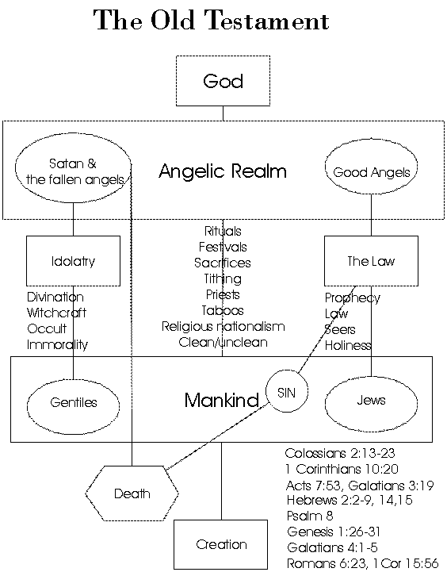

Slide 7
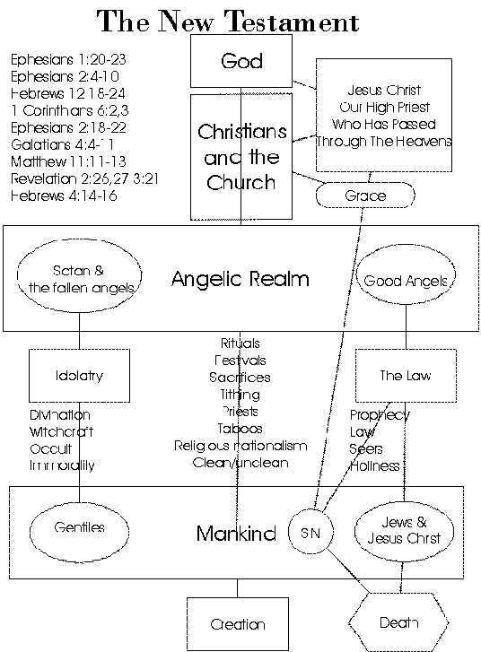

Slide 8
The Heavenly Realms
Above the Heavens - God – A Place of Great Glory
3rd Heaven – The Throne of God
Satan was cast out of the Third Heaven, was in the 2nd Heaven before the cross. After being defeated by Christ he is now ‘prince of the power of the air (1st heaven)
2nd Heaven – Angels / Spiritual Warfare
1st heaven - Air
Satan will be cast to the Earth and this will bring about the Tribulation, he will then end up in the Pit and later in the Lake of Fire
Earth
Abraham’s Bosom (Good)
Sheol
Hades – Bad ?Torment
At the cross Sheol was emptied of the good . And the bad area Hades became Hell
Hades /Hell
The Pit
The Lake Of Fire

Slide 9
The Three Heavens
The word Heaven is plural “shamayim” or “ouranoi” (Gk). There are three heavens or “shamayim” mentioned in Scripture.
Above the Heavens – where God’s glory dwells and where Satan once aimed to be. (Psalm 8:1, 108:4,5, Ephesians 1:20, 4:10, Isaiah 14:12-14)
Third Heaven (2 Corinthians 12:2) – the Throne, where Paul went and heard holy things.
Second Heaven (Revelation 12:4-12, 14:6,7) –Where Satan and fallen angels first fell to and demons are fighting for now. First Heaven (Genesis 1:20, Psalm 104:12, Daniel 2:38) – birds dwell, Satan dwells as prince of the power of the air since the cross.

Slide 10
The Lower Realms
Earth esp. “The Face Of The Earth” (Genesis 6:1, Acts 17:26Job 1:7,2:2, 1 Peter 5:8) – the place of human habitation, also where Satan prowls, and will be cast down to in the end times. Hades/ The Grave/Under The Earth /In The Sea/The Deep (Genesis 1:2, Exodus 20:4, Deuteronomy 5:8, Job 28:14, Philippians 2:10, Revelation 5:3) – the place human bodies, human souls before the cross, and the strange creatures of the deep dwell. In 1 Samuel 28:15 the prophet is “brought up” by the witch of Endor. Presently where the souls of the disgraced dead dwell. n Matthew 27:52,53 there is a partial resurrection of the righteous OT saints “from the graves”. Abyss/the Bottomless Pit/(Isaiah 14:11-15; Numbers 16:33, Ezekiel 32:15-18 Luke 8:31, 10:7, Revelation 9:1,2; 20:1-3) – where confined demons dwell The Lake of Fire (Revelation 19;20, 20:10-15) – a future place of eternal punishment prepared for the Devil and his angels and those who accept the mark of the Beast.

Slide 11
Lower Realms - 2
“Sheol” is a general Hebrew term covering the entire world of the dead. Luke 16 indicates that Abraham’s bosom is a place of comfort in the OT world of the dead. Job indicates that some of the dead experienced rest and reunion with relatives hence the term ‘gathered to one’s people”. (Job 3:17-22, Genesis 15:15, 25:8,17; Deut 32:50). Abraham’s Bosom was emptied at the croso.
Abbadon or Destruction (Gk Apollyon) is the name of the angel that guards the Pit (Revelation 9:11) and thus Hell is given the name Abaddon in Job 26:6, 28:22, Proverbs 15;11. It is seen as a place of silence, loss of identity and oblivion as well as of torment. There is no knowledge of God just active torment and judgment. (Pslam 6:5, 88:12, Deut 32:22) God’s Presence is till there – as wrath. (Psalm 139;8)
Tartarus was the legendary Greek place of extreme torment. 2 Peter 2:4 indicates that the rebellious demons were confined here. It seems equivalent to the Pit.

Slide 12
The Rebels Against God
The angels who sinned (2 Peter 2:4) and are now kept in chains awaiting judgment
Those who are ‘principalities and powers in the heavenly realms’ and ‘of the air’ (Ephesians 6:10, 2:1-4) and which influence mankind today (2 Thessalonians 2:7,9)
The demons and unclean spirits that dwell in human bodies and even seek water. (Matthew 8:28-34, 12:22-28, 43-45)
These beings only have the authority that we grant them through sin because they have no authority from God
They do have a certain amount of power and wicked energy

Slide 13
Our Role…
We cast out demons (Matthew 10:1,8; Mark 3:14,15; 16:17; Luke 9:1,2, 10: 17,18)
We wrestle against principalities and powers (Ephesians 6:10-18)
We will judge the fallen angels (1 Corinthians 6:2,3)
We will crush Satan under our feet (Romans 16:20)
This is done by the delegated authority we receive from God and by His power and assistance

Slide 14
Receiving Authority
Great authority can be given in an instant: Joseph, Daniel, Queen Esther etc.
It is entirely the decision of the King as to who gets the position of authority. It is not earned.
We are given the authority to become sons of God when we believe in His name (John 1:12, Ephesians 1:19-21, 2:6)
The Holy Spirit delegates authority to carry out God’s work (apostles, prophets, evangelists, pastors and teachers) - (Acts 20:28, Ephesians 4:11, 2 Timothy 1:11)
Faithfulness leads to an increase in authority while careless unfaithfulness leads to a decrease in authority (Matthew 24:45-51, 25:14-30)

Slide 15
Receiving Power
Power is given when the Holy Spirit “comes upon” someone to work through them: Numbers 11:25, 24:2, Judges 14:6,19; 2 Kings 2:9, Matthew 3:16, Mark 1:10, John 1:33)
The Holy Spirit comes upon Christians via the baptism in the Holy Spirit: (Acts 1:8, 2:17,18; 10:44,45; 11:15, 19:6)
The Holy Spirit within us produces wisdom, regeneration and sanctification (e.g. Galatians 5:22,23)
The Holy Spirit upon us gives us power in ministry.

Slide 16
Receiving “Energy”
“Energeia” power is unleashed by faith – by believing in His name (Galatians 3:5, Ephesians 1:18,19)
It is a gift that is given as the Holy Spirit wills. (1 Corinthians 12:1-11,27-31)
It is closely linked to doing miracles and moving mountains and having the ‘energy’ of God working through us in body-life ministry. (Philippians 4:13, Ephesians 3:7, 4:16)
It also works through us via self-purification and humility (getting out of the way) Philippians 3:7-14
The Earthen Vessel (2 Corinthians 4:7-18, 2 Timothy 2:20,21)

Slide 17
The Purpose…
“For the building up of the church in love…” (Ephesians 4:11-16)
For mutual benefit (1 Corinthians 12:4-7)
For edification and building up (1 Corinthians 14:26, 2 Corinthians 10:8,12:19, 13:10, Jude 1:20))
It is not for ‘solo’ purposes but for the greater good
Must be exercised in love (1 Corinthians 13:1-3)
And in the will of God (Matthew 7:21-23)

Slide 18
In Practice - 1
Authority- Command Prayer,
giving orders, ‘say to this mountain…’ ,
Casting out demons ‘with a word
Rebuking sickness
Calling wholeness into being
opening up the boundaries of your faith, mustard-seed faith, believing God, and speaking it into being
Focus on the desired (will of God) picture of perfection
(Matthew 17:20, 21:21, Mark 11:22-26, 1 Corinthians 13:2)

Slide 19
In Practice - 2
Power & Energy
Ask for the Holy Spirit to come ‘upon you’. Ask for the baptism in the Holy Spirit. Laying on of hands. (Acts 8:18,19, Hebrews 6:2)
Seek spiritual gifts (1 Corinthians 14:1,2)
Spend time in worship. (1 Corinthians 12-14)
Move as the Spirit leads you to move. (Acts 3 – healing of the lame man)
Energies – Releasing Prayer, letting Christ in you do the ministry, trusting God to move through you as an earthen vessel.

Slide 20
In Practice 3
Mark 6:1-6 And He went out from there and came into His native-place. And His disciples followed Him (3) Is not this the carpenter, the son of Mary, the brother of James and Joses and Judas and Simon? And are not his sisters here with us? And they were offended at Him. (4) But Jesus said to them, A prophet is not without honor, except in his native-place, and among his own kin, and in his own house. (5) And He could do no work of power there, except that He laid His hands on a few sick ones, He healed them. (6) And He marveled because of their unbelief. And He went around the villages, in a circuit, teaching.
Jesus who had great power and authority was UNABLE to do any mighty works (dunamin) in Nazareth because ‘of their unbelief’.
Skepticism kills the ability of even the best healer or miracle worker

